Slide 1
School Ranking Analysis
SQL Script

Slide 2
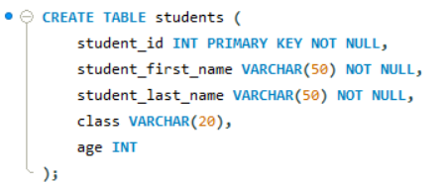
Write a query to create a students table with appropriate data types for student id, student first name, student last name, class, and age where the student last name, student first name, and student id should be a NOT NULL constraint, and the student id should be in a primary key.

Slide 3
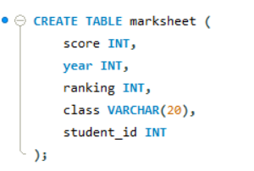
Write a query to create a marksheet table that includes score, year, ranking, class, and student id.

Slide 4
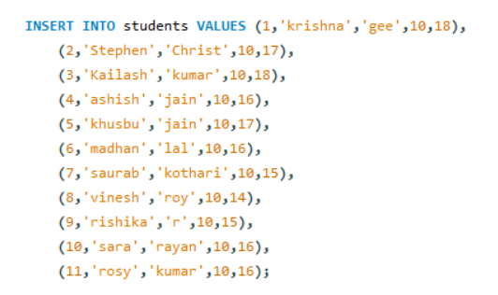
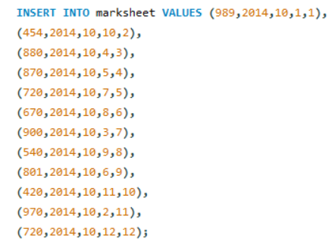
Write a query to insert values in students and marksheet tables.

Slide 5
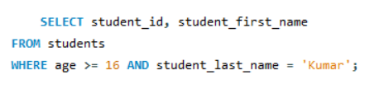
Write a query to display student id and student first name from the student table if the age is greater than or equal to 16 and the student's last name is Kumar.

Slide 6
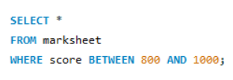
Write a query to display all the details from the marksheet table if the score is between 800 and 1000.

Slide 7

Write a query to display the marksheet details from the marksheet table by adding 5 to the score and by naming the column as new score.

Slide 8

Write a query to display the marksheet table in descending order of the score.

Slide 9
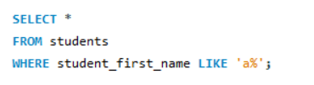
Write a query to display details of the students whose first name starts with a.

Slide 10
THANK YOU

